Slide 1


Online Recipe Sharing Platform
Our online platform empowers home cooks to discover, create, and share delicious recipes from around the world. Explore a vibrant community of food enthusiasts and unlock a world of culinary inspiration.
Nitin Tripathi(23SCSE1011785) Abhishek Anand(23SCSE1011902)
Prince(23SCSE1011819) Awanish Kumar Vishwakarma(23SCSE1011201)

Slide 2

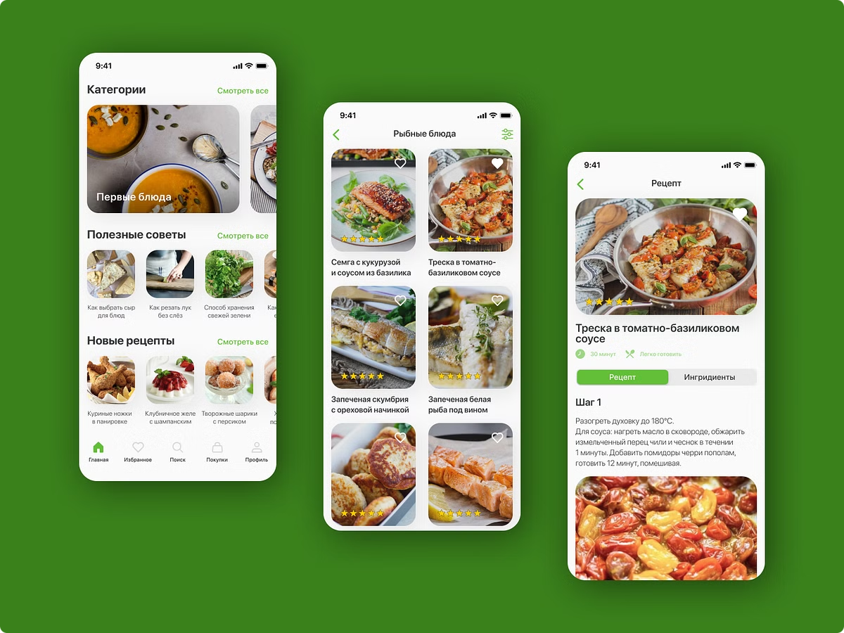

App Description
Intuitive Design
Personalized Feeds
Our app features a clean, user-friendly interface that makes recipe browsing and sharing a breeze.
Receive tailored recipe recommendations based on your dietary preferences and cooking experience.
Multimedia Content
Enhance your cooking journey with step-by-step recipe videos, mouthwatering food photography, and helpful cooking tips.

Slide 3


Our Mission and Vision
Empower Home Cooks
Inspire and equip home cooks with the tools and knowledge to master culinary skills.
Foster Community
Build a vibrant online community where food enthusiasts can connect, share, and learn from one another.
Celebrate Diversity
Promote cultural exchange and appreciation through the exploration of diverse cuisines and cooking traditions.

Slide 4
Key Features of the Platform
Recipe Creation
Social Sharing
Personalized Recommendations
Easily upload your own recipes, complete with ingredients, step-by-step instructions, and eye-catching photos.
Share your culinary creations with the community and engage with fellow home cooks.
Discover new recipes tailored to your dietary preferences, cooking level, and flavor preferences.

Slide 5

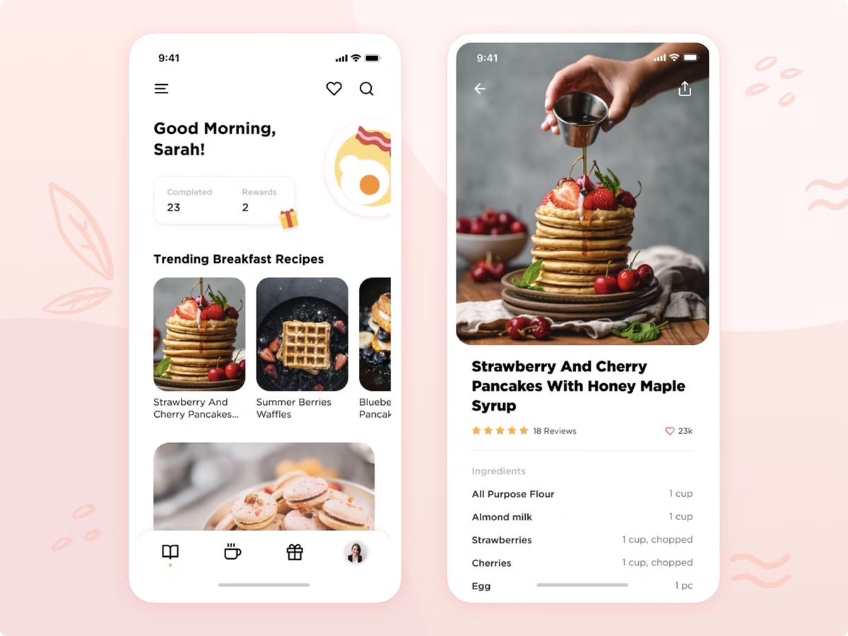




Creating and Sharing Recipes
Upload Photos
Ingredient Lists
Capture your culinary masterpieces and showcase them with the community.
Provide a clear and comprehensive list of ingredients for your recipes.
Step-by-Step
Social Sharing
Guide fellow home cooks through your recipe with detailed instructions.
Easily share your creations with the community and engage with others.

Slide 6

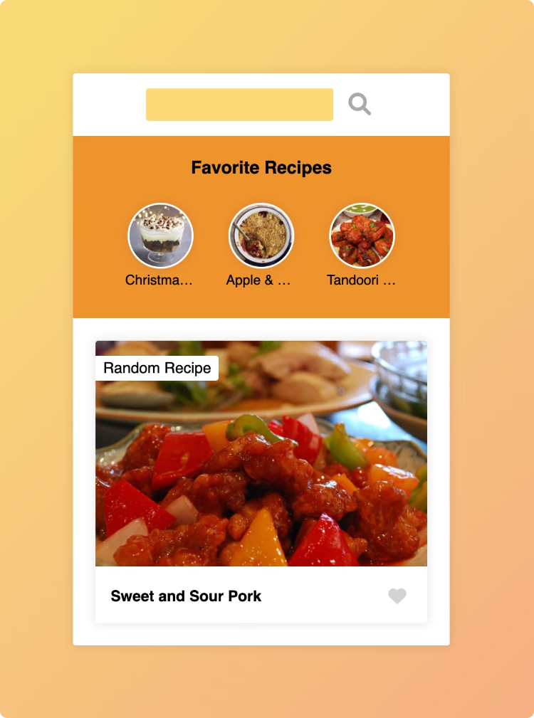
Discovering New Dishes and Flavors
1
Explore Cuisines
2
Filter by Dietary Needs
Discover a world of culinary diversity by browsing recipes from different cultural traditions.
Cater to your specific dietary preferences and restrictions with our advanced search tools.
3
Trending Recipes
4
Personalized Recommendations
Stay up-to-date with the latest food trends and top-rated recipes from the community.
Let our smart algorithm suggest recipes tailored to your cooking experience and taste preferences.

Slide 7
Modules of the App
Recipe Library
Community Feed
Guided Cooking
Browse and search our extensive database of user-submitted recipes across a variety of cuisines.
Connect with other home cooks, share your creations, and engage with the latest posts.
Follow step-by-step video tutorials to master new cooking techniques and recipes.

Slide 8

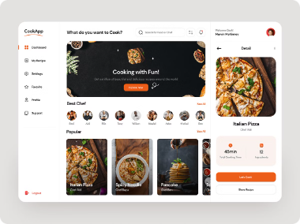



Future Roadmap and Platform Designs
Meal Planning
Voice Commands
Virtual Cooking Classes
Integrate a meal planning feature to help users organize their weekly menus.
Develop voice-activated controls to enhance the hands-free cooking experience.
Offer interactive online cooking classes taught by renowned chefs and culinary experts.

Slide 9

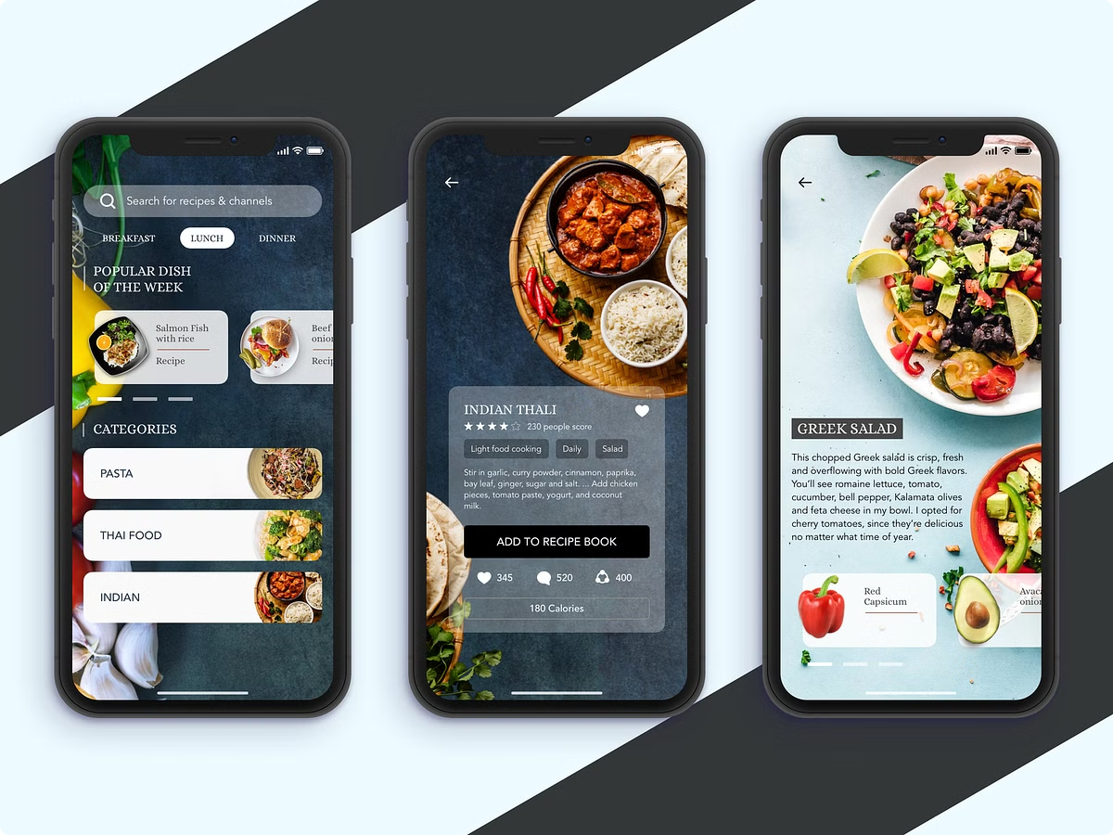
Structure of the App
Home Feed
Discover personalized recipe recommendations and trending dishes.
Recipe Library
Browse our extensive database of user-submitted recipes.
Community
Engage with other home cooks, share your creations, and join discussions.
Profile
Manage your account, update preferences, and track your cooking activity.

Slide 10


Conclusion
Our online recipe sharing platform is designed to empower home cooks, foster a vibrant culinary community, and celebrate the diversity of global cuisines. Join us on this exciting journey of culinary discovery and inspiration.

